Slide 1
MS Access
Lab 28: Add Data to a Table

Slide 2


Welcome to MS Access Class

Slide 3

What is Data Types?
A field's data type determines what kind of data it can store. MS Access supports different types of data, each with a specific purpose.
The data type determines the kind of the values that users can store in any given field.
Each field can store data consisting of only a single data type.

Slide 4
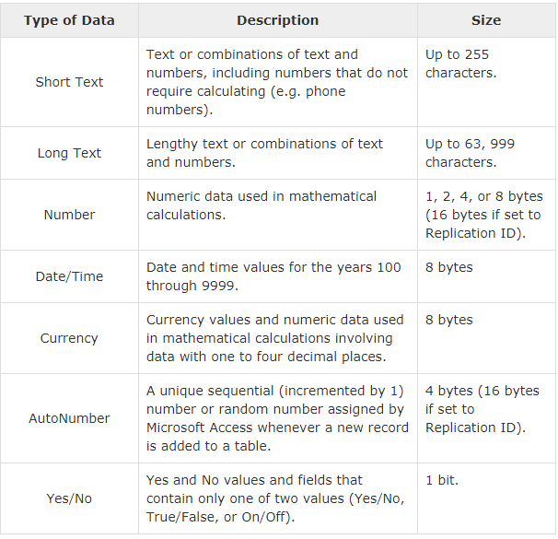
Data Types
Here are some of the most common data types you will find used in a typical Microsoft Access database.

Slide 5
Database
Add Data to a Table

Slide 6
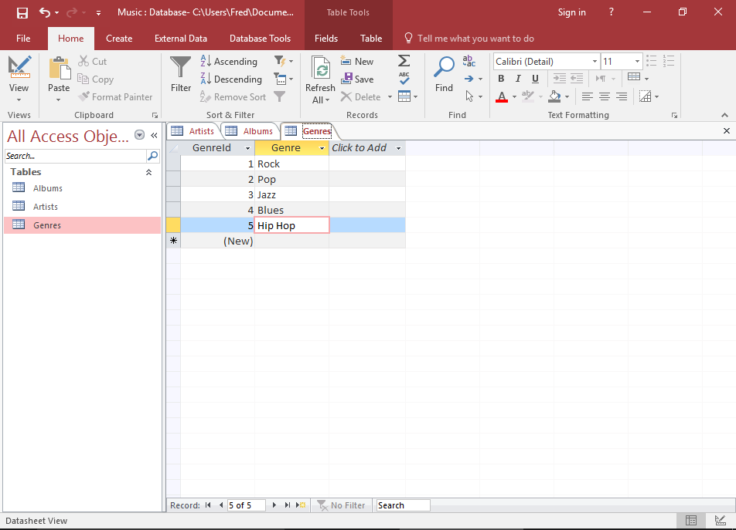
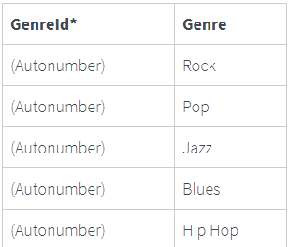
Add Data to a Table
1. Add Records Directly into Datasheet View
This is probably the most obvious way to enter data into a database. Just open up the table and start typing.
Open the Genres table in Datasheet View and enter the following data:

Slide 7
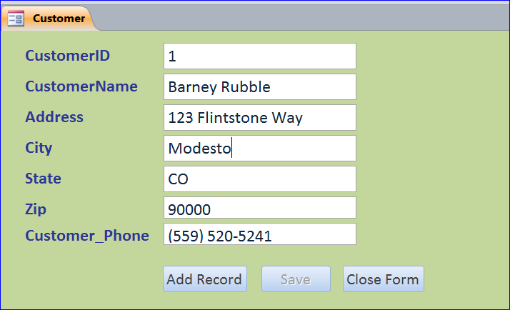
Add Data to a Table
2. Add Data using a Form
This will allow us to enter data without needing any technical knowledge about Microsoft Access. Forms can also improve usability and increase productivity.

Slide 8

Add Data to a Table
3. Add Data using SQL
SQL (Structured Query Language) is a query language designed specifically for relational databases. Access uses SQL to carry out the tasks that we specify through the user interface.
An example of an SQL statement to insert data looks like this:

Slide 9

Add Data to a Table
4. Import Data from an External Source
Access provides us with the ability to import data from external sources. Many different data formats are supported, and they can be imported directly to an existing table or a new one can be created based on the source data.

Slide 10

Thank You!

